Slide 1
Introducing the Android Platform

Slide 2
Outline
Overview
The History
The Dalvik VM
Android vs. J2ME
Why Android

Slide 3
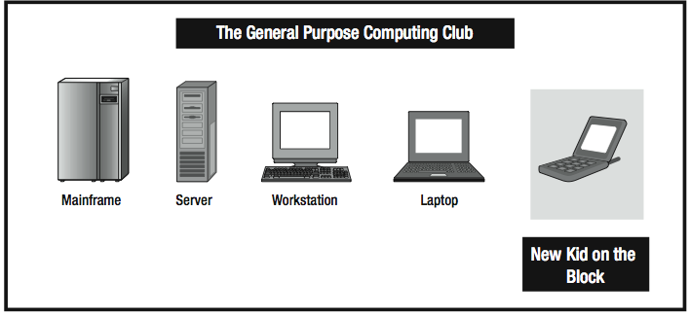
Overview
Personal computing become more “personal”

Slide 4
Overview
The Android OS
  Google join the hand-held party
  Fully embraces the idea of general-purpose computing for hand- held devices
  Linux-based OS
The Android SDK
  Supports most of J2SE
  Included most of library of desktop/server (graphic, browser, relational database …)

Slide 5
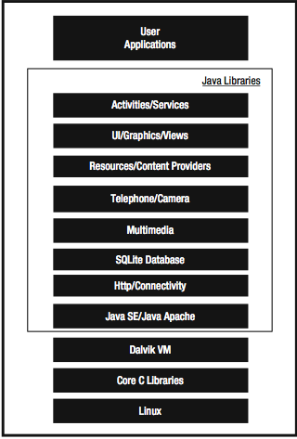
Overview
Dalvik VM
  Android offers its own optimized JVM

Slide 6
History of Android
2005, Google buy Android Inc.
Late 2007, OHA Announced, “early look” release of Android SDK (Nov 2007)
Sep 2008, T-Mobile G1 Announced
Oct 2008, Android SDK 1.0 released
Apr 2009, Android SDK 1.5 released
Sep 2009, Android SDK 2.0 released
Jan 2010, Android SDK 2.1 released

Slide 7
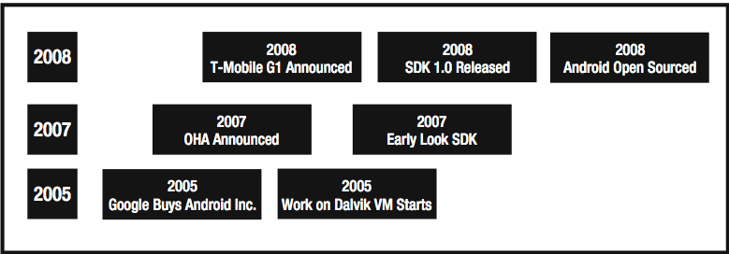
History of Android

Slide 8
Dalvik VM
The problem
  Limitation of computing resources
  JVM cannot solve the problem about computing resouces
Google revisit the standard JVM implementation (Dan Bornstein)
  Dalvik VM

Slide 9
Dalvik VM
Compile java class files to .dex files
  Reuses duplicate information from multiple class files
  Reducing the space requirement
Fine-tuned the garbage collection
  Missing just-in-time (JIT) compiler
Different kind of assembly-code generation
  Uses registers instead of the stack
Excutable files is not class files but .dex files

Slide 10
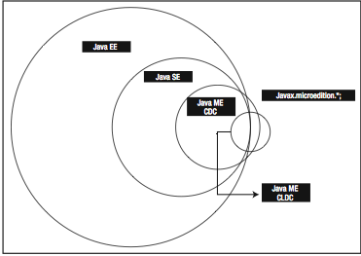
Android vs. J2ME
J2ME (CDC vs. CLDC)

Slide 11
Android vs. J2ME
Multiple device configurations
  J2ME has 2 classes of micro devices
  Android offers only one
Ease of understanding
  J2ME has multiple UI model (MIDlets, Xlets, AWT, Swing …)
  Android support for only one, so it would be more easier to understand than J2ME

Slide 12
Android vs. J2ME
Responsiveness
  Dalvik VM vs. JVM
  Dalvik VM vs. KVM
Java compatibility
  Android runs .dex bytecode
  Runtime interpretation of Java bytecode is not possible

Slide 13
Android vs. J2ME
Adoption
  Most of mobile phone support for J2ME
  But uniformity, cost, ease of development in Android are the reasons for java developer to program for it
Java SE support
  Android support for J2SE more complete than J2ME CDC (except AWT & Swing)

Slide 14
Why Android
For mobile makers
  Open source
  Free license
  Easier to research and develop
For developers
  Develop applications in Java
  Friendly and cross platform environment (Eclipse)
  Easier to deploy applications
  A lot of opportunities in out sourcing industry

Slide 15
Why Android
For end users
  No license fee
  More than 30K application in the market with 61% are free apps
  Supported by dozens of hardware manufacturers
  Low price smart-phone devices
  Abilities to integrate with Google’s services

Slide 16
Q &A

